Slide 1
UNIVERSITY INSTITUTE OF ENGINEERING
Department of Computer Science & Engineering
Databases Management System
(23CSH-205/23ITH-205)
DR. GITANJALI
E16525
ASSISTANT PROFESSOR
CSE
DISCOVER . LEARN . EMPOWER

Slide 2
ABOUT COURSE
The main DBMS course, we learn about the structural formation of data, maintain data integrity, multitasking with concurrent access and recovery without occurring crashes, data structures, data models etc. and their working in which every organization is based.
At the end of the course, the students may understand the concepts of data structures, data models and design, construction of queries by using SQL, uses and applications of database design etc

Slide 3
COURSE OUTCOMES
CO No. | Title | BT Level
CO1 | Students will be able to understand the database system concepts and design databases for different applications. | Memorize
CO2 | Students will be able to identify different types of DDL, DML, DCL and TCL commands and their usage. | Understanding
CO3 | Students will be able to classifying Normalization, Dependencies and Denormalization along with their requirements. | Apply
CO4 | Students will be able to analyse and Compare Transaction Processing techniques and Recovery techniques. | Analyze
CO5 | Students will be able to evaluate database performance after implementing Triggers, procedures, packages, cursors and views. | Evaluate
Will be covered in this lecture

Slide 4
COURSE OBJECTIVES
This course will enable students to,
To have good understanding of database system concepts and design databases for different applications.
To learn how to use a DBMS and RDBMS.
To implement and understand different types of DDL, DML and DCL statements.
To understand transaction concepts related to databases and recovery/backup techniques required for the proper storage of data.

Slide 5
Topics covered
Functional dependencies and Normalization:
Functional dependencies, Decomposition, Full Functional Dependency (FFD), Transitive Dependency (TD), Join Dependency (JD), Multi-valued Dependency (MVD), Normal Forms (1NF, 2NF, 3NF, BCNF), De-normalization.

Slide 6
Key terms
Here, are some key terms for functional dependency:
Key Terms | Description
Axiom | Axioms is a set of inference rules used to infer all the functional dependencies on a relational database.
Decomposition | It is a rule that suggests if you have a table that appears to contain two entities which are determined by the same primary key then you should consider breaking them up into two different tables.
Dependent | It is displayed on the right side of the functional dependency diagram.
Determinant | It is displayed on the left side of the functional dependency Diagram.
Union | It suggests that if two tables are separate, and the PK is the same, you should consider putting them. together

Slide 7
Types of Dependency
Functional Dependency
Partial Dependency
Fully Functional Dependency
Multivalued dependency
Transitive dependency

Slide 8

Functional Dependency
A dependency function (FD) is a database constraint that determines the relationship of one attribute to another in a database management system (DBMS). Functional dependencies help maintain the quality of data in the database. Functional dependence is a relationship that exists between two attributes. It usually exists between the primary key and non-prime attributes in the table.
Example: X -> Y
In this case, the left side of the arrow is the determinant and the right of the arrow is dependent. X will be the primary attribute and Y will be a non-prime attribute of the table. It shows that the attributes of column X uniquely identify the attribute of column Y to satisfy this functional dependency.

Slide 9

Functional Dependency
How to represent functional dependency in DBMS?
Functional Dependency is expressed in the form of equations. Here you have an array of objects (A, B, C, etc.) and an arrow (->) that represents the dependency. For example, if we have an employee record with fields "EmployeeID", "FirstName" and "LastName", we can specify the function as follows:
EmployeeID -> FirstName, LastName
To represent functional dependency in DBMS has two main features: left (LHS) and right (RHS) of the arrow (->).

Slide 10
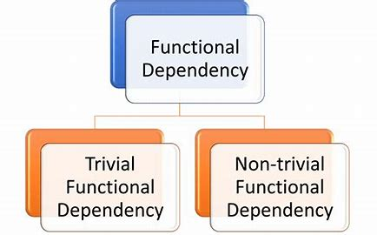
Functional Dependency

Slide 11
Functional Dependency
Types of Functionality in DBMS
Trivial Functional Dependency: Trivial functional dependency occurs when an attribute or attributes (columns) appear in the DBMS. When the (->) function is present, the left element (LHS) already determines the right element (RHS) without additional information.
Example: Suppose we have a student table with attributes "EmployeeID" and "EmployeeName". In this case, if we declare the dependency function as
EmployeeID -> EmployeeName
It will be a rivial functional dependency. Because there is only one "EmployeeName" in "EmployeeID". That is, the value of "EmployeeID" determines the value of "EmployeeName" without the need for any additional information or conditions.

Slide 12
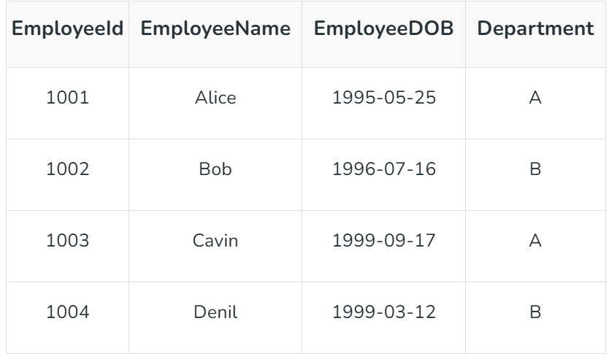
Functional Dependency

Slide 13
Functional Dependency
Non-trivial Functional Dependency
Non-trivial functional dependencies are a type of dependency between attributes (columns) in a table. Here the relationship is neither obvious nor important. It provides valuable information about how values ​​in one feature set determine values ​​in another feature set.
Example: Here is the functional dependency based on the employee's date of birth (EmployeeDOB) and Department. In this case the non-trivial dependency will be
EmployeeDOB, Department -> EmployeeName.
In this functional dependency given combination of employee's date of birth and class can uniquely determines employee names. It is important because it provides important information about the relationship between attributes in the language.

Slide 14

Functional Dependency
Properties of Functional Dependency in DBMS
Reflexivity: If A is a set of attributes and B is a part of A, then the function A -> B is valid.
Augmentation: If the A -> B dependency is valid, adding multiple elements to either side of the dependency will not affect the dependency.
Transitivity: If the functions X → Y and Y → Z are both valid, then X → Z is also valid according to the transitivity rule.
Advantages of functional dependency in DBMS
Data Integrity
Normalization
Effective Storage
Easy to maintain

Slide 15
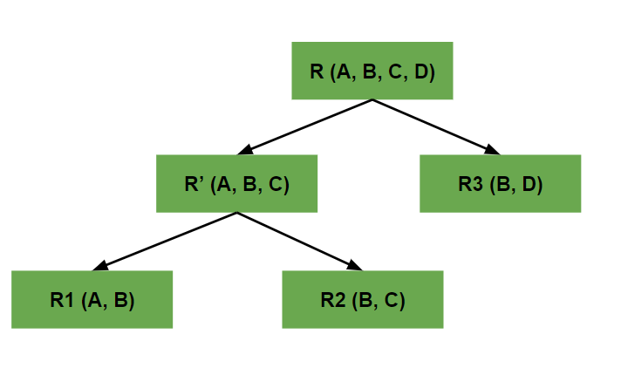
Decomposition
What is Decomposition in DBMS?
When we divide a table into multiple tables or divide a relation into multiple relations, then this process is termed Decomposition in DBMS. We perform decomposition in DBMS when we want to process a particular data set. It is performed in a database management system when we need to ensure consistency and remove anomalies and duplicate data present in the database. When we perform decomposition in DBMS, we must try to ensure that no information or data is lost.
Types of Decomposition
There are two types of Decomposition:
Lossless Decomposition
Lossy Decomposition

Slide 16
Decomposition
Properties of Decomposition
Lossless: All the decomposition that we perform in Database management system should be lossless. All the information should not be lost while performing the join on the sub-relation to get back the original relation. It helps to remove the redundant data from the database.
Dependency Preservation: Dependency Preservation is an important technique in database management system. It ensures that the functional dependencies between the entities is maintained while performing decomposition. It helps to improve the database efficiency, maintain consistency and integrity.
Lack of Data Redundancy: Data Redundancy is generally termed as duplicate data or repeated data. This property states that the decomposition performed should not suffer redundant data. It will help us to get rid of unwanted data and focus only on the useful data or information.

Slide 17

Fully Functional Dependency
What is Fully Functional Dependency?
Real-life dependencies emerge when, within one relationship, the value of one of the attributes is capable of identifying the value of another attribute. Simply put, if A fully determines B without any proper subset of A giving full cause to B, then A is said to fully depend on B. In other words, you cannot derive B from a smaller part of A.
An Example of Fully Functional Dependency
To visualize a relation called "Employee” with the attributes {Employee_ID, Employee_Name, Department, Salary}, use the following diagram: Basically, if that the Employee_ID attribute figures out the other attributes in the table, such as the Employee_Name, Department, and Salary, the Employee_ID attribute fully functionally depends on all these attributes.

Slide 18
Fully Functional Dependency
Importance of Fully Functional Dependency
Data Integrity: Instantaneous reference derives ones and only one value from others on the elements, which provides data integrity.
Normalization: Finding and ensuring all the relationships are incomplete for one (and only one) of the attributes is the central part of the normalization process. It plays a role in recording large tables into smaller, structured tables, which reduces redundancy and helps people to handle transactions successfully.
Efficient Queries: Databases with well-thought-out dependencies that provide maximum functionality are usually the ones that tend to outperform in query response. In the data has a logical structure, the search process becomes faster as time goes by.
Update Anomalies: All major operations will be enabled by this through reduced anomalies in updates. An update anomaly happens when performing an action on one attribute results in the ratification other attributes or errors.

Slide 19
Functional Dependency
Types of Dependencies
Partial Dependency
Full Dependency
Transitive Dependency
A Partial Dependency occurs when a non-prime attribute (an attribute that is not part of any candidate key) depends on part of a composite primary key rather than the whole key.
OrderID, ProductID, ProductName, Quantity
OrderID and ProductID together form the composite primary key.
ProductName depends only on ProductID (not on the whole composite key).
This is a Partial Dependency because ProductName is determined by a part of the composite key (ProductID), not the entire key.

Slide 20
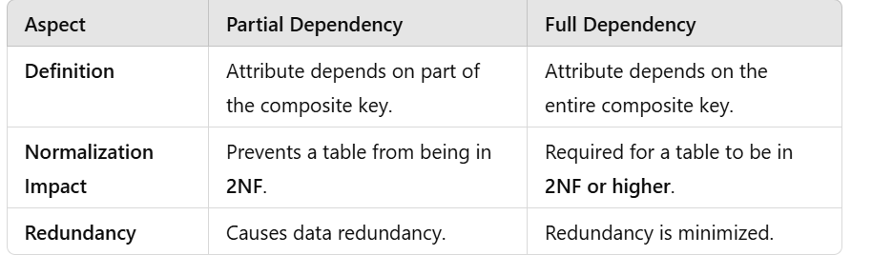
Functional Dependency
A Full Dependency occurs when a non-prime attribute depends on all parts of a composite primary key and not just a subset.
Example:
OrderID, ProductID, Quantity
Quantity depends on both OrderID and ProductID.
This is a Full Dependency because Quantity depends on the entire composite primary key.

Slide 21

Functional Dependency
Transitive Dependency
If the value of a non-primary attribute can be defined using another non-primary attribute, then it is called a transitive dependency.
When any attribute does not require primary key and can easily get value using another non-primary attribute then it is called as Transitive Dependency.
Example
Let's take an example, we have a table where we have columns of student roll number, name, city where student live, and zip-code of city .

Slide 22
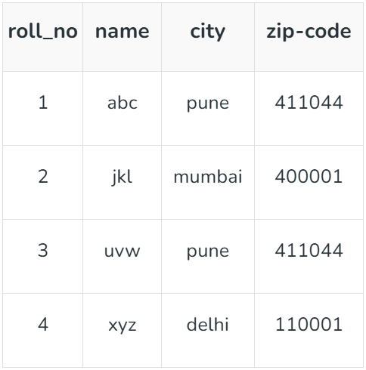
Functional Dependency
Here the primary key is roll_no but we can identify the city using zip-code where city and zip-code both are the primary key
So here roll_no → city and city→zip-code eventually resulting into roll_no →zip-code. so, we can find a non-primary attribute using another non-primary attribute. For example, roll-no = 1 has city=pune and city=pune will have zip-code=411044.So wherever city is pune , zip-code will be 411044
This type of functional Dependency is known as Transitive Dependency.

Slide 23
Join Dependency
Join Dependency (JD) can be illustrated as when the relation R is equal to the join of the sub-relations R1, R2,..., and Rn are present in the database. Join Dependency arises when the attributes in one relation are dependent on attributes in another relation, which means certain rows will exist in the table if there is the same row in another table. Multiple tables are joined to create a single table where one of the attributes is common in the sub-tables. We can also relate the join dependency to the 5th Normal Form. A join dependency is said to be not that important if any relational schemas in the join dependency are equivalent to the original relation R.
Join dependency on a database is denoted by:
R1 ⨝ R2 ⨝ R3 ⨝ ..... ⨝ Rn ;
where R1 , R2, ... , Rn are the relations and ⨝ represents the natural join operator.

Slide 24
Join Dependency
Types of Join Dependency
There are two types of Join Dependencies:
Lossless Join Dependency: It means that whenever the join occurs between the tables, then no information should be lost, the new table must have all the content in the original table.
Lossy Join Dependency: In this type of join dependency, data loss may occur at some point in time which includes the absence of a tuple from the original table or duplicate tuples within the database.
Importance of Join Dependencies
Data Integrity: Join Dependency helps maintain data integrity in a database. Database designers can make sure that the queries are consistent after checking for the dependencies. This will remove the data that is not accurate.
Query Optimization: Query optimization leads to improving the performance of the database system. The database designers can choose the best join order to execute the queries which in turn reduces the computational costs, memory utilization and i/o operations to get the queries executed quickly.

Slide 25


Multivalued Dependency
Multivalued Dependency
When one attribute in a database depends on another attribute and has many independent values, it is said to have multivalued dependency (MVD). It supports maintaining data accuracy and managing intricate data interactions.
Example of Multivalued Dependency:

Slide 26
Introduction to Normalization
Normalization: Process of decomposing unsatisfactory "bad" relations by breaking up their attributes into smaller relations
Normalization is the process of removing redundant data from your tables in order to improve storage efficiency, data integrity and scalability.
This improvement is balanced against an increase in complexity and potential performance losses from the joining of the normalized tables at query-time.
There are two goals of the normalization process: eliminating redundant data (for example, storing the same data in more than one table) and ensuring data dependencies make sense (only storing related data in a table). Both of these are worthy goals as they reduce the amount of space a database consumes and ensure that data is logically stored.

Slide 27
Introduction to Normalization
Normal form: Condition using keys and FDs of a relation to certify whether a relation schema is in a particular normal form
2NF, 3NF, BCNF based on keys and FDs of a relation schema
4NF based on keys, multi-valued dependencies
There is a sequence to normal forms:
1NF is considered the weakest,
2NF is stronger than 1NF,
3NF is stronger than 2NF, and
BCNF is considered the strongest
Also,
any relation that is in BCNF, is in 3NF;
any relation in 3NF is in 2NF; and
any relation in 2NF is in 1NF.

Slide 28
WHY WE NEED NORMALIZATION?
Normalization is the aim of well design Relational Database Management System (RDBMS). It is step by step set of rules by which data is put in its simplest forms. We normalize the relational database management system because of the following reasons:
Minimize data redundancy i.e. no unnecessarily duplication of data.
To make database structure flexible i.e. it should be possible to add new data values and rows without reorganizing the database structure.
Data should be consistent throughout the database i.e. it should not suffer from following anomalies.
Complex queries required by the user should be easy to handle.

Slide 29
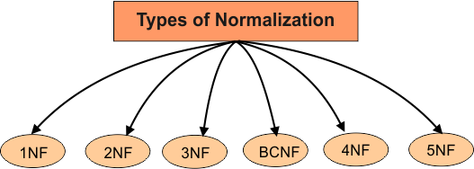
Types of Normalization

Slide 30
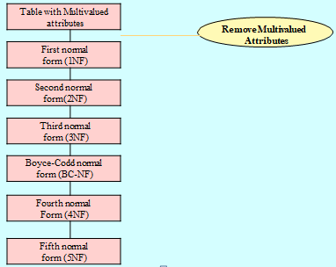
1 Normal Form
As per the rule of first normal form, an attribute (column) of a table cannot hold multiple values. It should hold only atomic values.

Slide 31
First Normal Form
Disallows composite attributes, multivalued attributes, and nested relations; attributes whose values for an individual tuple are non-atomic.
We say a relation is in 1NF if all values stored in the relation are single-valued and atomic.

Slide 32
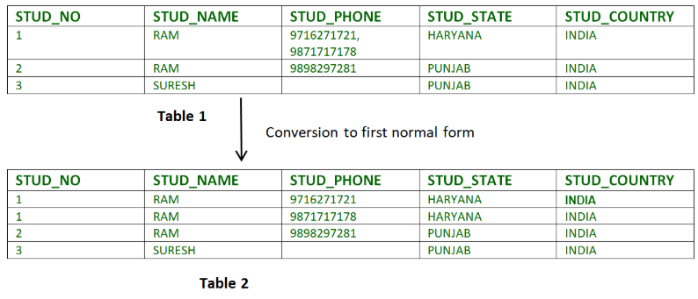
Normal Forms in DBMS
Example 1 – Relation STUDENT in table 1 is not in 1NF because of multi-valued attribute STUD_PHONE. Its decomposition into 1NF has been shown in table 2.

Slide 33
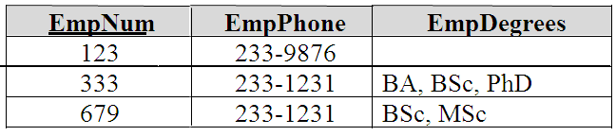
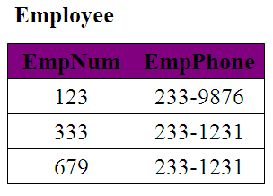
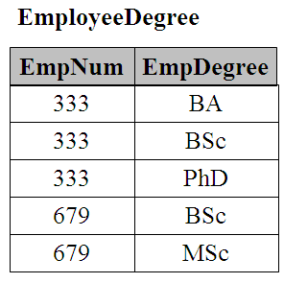
First Normal Form (1NF)
An outer join between Employee and EmployeeDegree will produce the information we saw before

Slide 34
Implication of INF
You must have single value in a single column, null value can be present.
Order of row and order of column is insignificant.
Every value must belong to same domain.
Every column should have unique name.

Slide 35
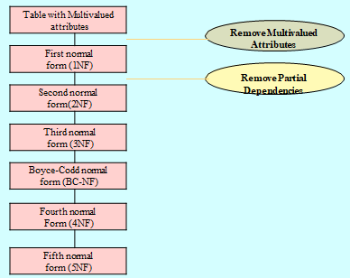

Slide 36

Second Normal Forms
A relation is in 2NF if it is in 1NF and any non-prime attribute (attributes which are not part of any candidate key) is not partially dependent on any proper subset of any candidate key of the table. In other words, we can say that, every non-prime attribute must be fully dependent on each candidate key.
A functional dependency X->Y (where X and Y are set of attributes) is said to be in partial dependency, if Y can be determined by any proper subset of X.
However, in 2NF it is possible for a prime attribute to be partially dependent on any candidate key, but every non-prime attribute must be fully dependent(or not partially dependent) on each candidate key of the table.
Second Normal Form

Slide 37

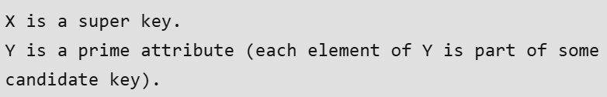
Example 2 – Consider following functional dependencies in relation R (A, B , C, D )
In the above relation, AB is the only candidate key and there is no partial dependency, i.e., any proper subset of AB doesn’t determine any non-prime attribute.

Slide 38
Second Normal Form
A relation is in 2NF if it is in 1NF, and every non-key attribute is fully dependent on each candidate key. (That is, we don’t have any partial functional dependency.)
2NF (and 3NF) both involve the concepts of key and non-key attributes.
A key attribute is any attribute that is part of a key; any attribute that is not a key attribute, is a non-key attribute .

Slide 39
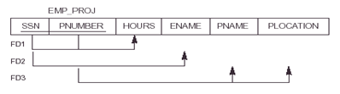
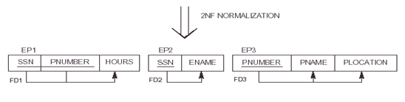
Second Normal Form

Slide 40
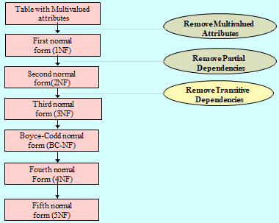

Slide 41
Third Normal Form
A relation is in the third normal form, if there is no transitive dependency for non-prime attributes as well as it is in the second normal form. A relation is in 3NF if at least one of the following conditions holds in every non-trivial function dependency X –> Y.
X is a super key.
Y is a prime attribute (each element of Y is part of some candidate key).
In other words,
A relation that is in First and Second Normal Form and in which no non-primary-key attribute is transitively dependent on the primary key, then it is in Third Normal Form (3NF).
Third Normal Form

Slide 42
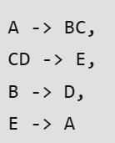
Third Normal Form
The normalization of 2NF relations to 3NF involves the removal of transitive dependencies. If a transitive dependency exists, we remove the transitively dependent attribute(s) from the relation by placing the attribute(s) in a new relation along with a copy of the determinant. Consider the examples given below. Y is a prime attribute (each element of Y is part of some candidate key).
Example 2: Consider Relation R(A, B, C, D, E)
All possible candidate keys in above relation are {A, E, CD, BC} All attribute are on right sides of all functional dependencies are prime.

Slide 43
Third Normal Form
A database is in third normal form if it satisfies the following conditions:
It is in second normal form
There is no transitive functional dependency
Definition
Transitive functional dependency – if there a set of atribute Z that are neither a primary or candidate key and both X –> Z and Y –> Z holds.

Slide 44
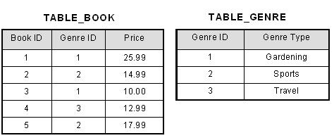
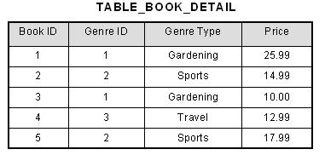
Third Normal Form
In the table able, [Book ID] determines [Genre ID], and [Genre ID] determines [Genre Type]. Therefore, [Book ID] determines [Genre Type] via [Genre ID] and we have transitive functional dependency, and this structure does not satisfy third normal form.
To bring this table to third normal form, we split the table into two as follows:
Now all non-key attributes are fully functional dependent only on the primary key. In [TABLE_BOOK], both [Genre ID] and [Price] are only dependent on [Book ID]. In [TABLE_GENRE], [Genre Type] is only dependent on [Genre ID].

Slide 45
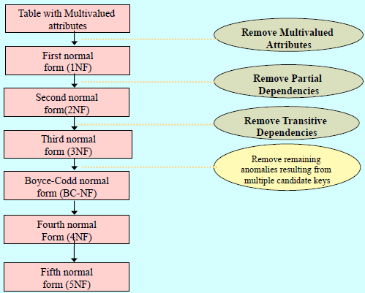
The difference between 3NF and BCNF is that for a functional dependency A🡪 B, 3NF allows this dependency in a relation if B is a primary-key attribute and A is not a candidate key, Whereas BCNF insists that for this dependency to remain in a relation, A must be a candidate key.

Slide 46

EXAMPLE
Consider this table:
FD set: {STUD_NO -> STUD_NAME, STUD_NO -> STUD_STATE, STUD_STATE -> STUD_COUNTRY, STUD_NO -> STUD_AGE}
Candidate Key: {STUD_NO}
For this relation in table , STUD_NO -> STUD_STATE and STUD_STATE -> STUD_COUNTRY are true. So STUD_COUNTRY is transitively dependent on STUD_NO. It violates the third normal form. To convert it in third normal form, we will decompose the relation STUDENT (STUD_NO, STUD_NAME, STUD_PHONE, STUD_STATE, STUD_COUNTRY_STUD_AGE) as:
STUDENT (STUD_NO, STUD_NAME, STUD_PHONE, STUD_STATE, STUD_AGE) STATE_COUNTRY (STATE, COUNTRY)

Slide 47
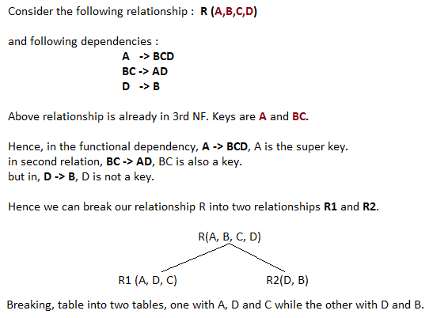
BCNF (Boyce-Codd Normal Form)
For a table to be in BCNF, following conditions must be satisfied:
R must be in 3rd Normal Form
and, for each functional dependency ( X -> Y ), X should be a super Key.

Slide 48

Rules for BCNF
Rule 1: The table should be in the 3rd Normal Form.
Rule 2: X should be a superkey for every functional dependency (FD) X−>Y in a given relation.
Example
Find the highest normal form of a relation R(A, B, C, D, E) with FD set as:
Explanation:
Step-1: As we can see, (AC)+ ={A, C, B, E, D} but none of its subsets can determine all attributes of the relation, So AC will be the candidate key. A or C can’t be derived from any other attribute of the relation, so there will be only 1 candidate key {AC}.
Step-2: Prime attributes are those attributes that are part of candidate key {A, C} in this example and others will be non-prime {B, D, E} in this example.
Step-3: The relation R is in 1st normal form as a relational DBMS does not allow multi-valued or composite attributes.

Slide 49
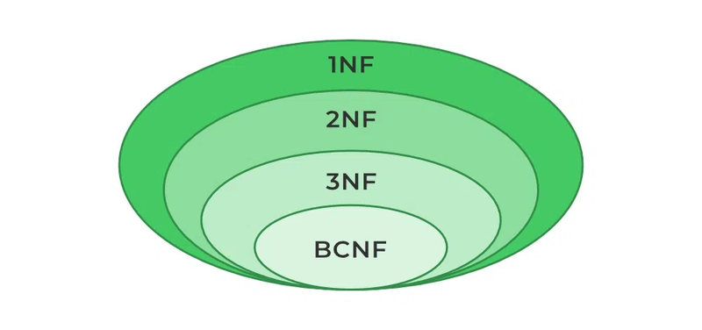
Boyce-Codd Normal Form (BCNF)
Although, 3NF is an adequate normal form for relational databases, this (3NF) normal form may not remove 100% redundancy because of X−>Y functional dependency if X is not a candidate key of the given relation. This can be solved by the Boyce-Codd Normal Form (BCNF).
Boyce-Codd Normal Form (BCNF) An advanced version of the third normal form, which is a little more strict. This is a tougher criterion that helps eliminate redundancy and anomalies from your Database. BCNF (Boyce-Codd Normal Form) is a further refinement of the third normal form which simplifies our database design.

Slide 50
Example:
For example consider relation R(A, B, C)
A -> BC, B -> A
A and B both are super keys so above relation is in BCNF.
Note –
BCNF decomposition may always not possible with dependency preserving, however, it always satisfies lossless join condition. For example, relation R (V, W, X, Y, Z), with functional dependencies:
V, W -> X Y, Z -> X W -> Y
It would not satisfy dependency preserving BCNF decomposition.
Note -:Redundancies are sometimes still present in a BCNF relation as it is not always possible to eliminate them completely.

Slide 51
Boyce Codd Normal Form
In BCNF:
When a relation has more than one candidate key, anomalies may result even though the relation is in 3NF.
3NF does not deal satisfactorily with the case of a relation with overlapping candidate keys
i.e. composite candidate keys with at least one attribute in common.
BCNF is based on the concept of a determinant.
A determinant is any attribute (simple or composite) on which some other attribute is fully functionally dependent.
A relation is in BCNF is, and only if, every determinant is a candidate key.
Definition: A relation is in Boyce-Codd Normal Form (BCNF) if every determinant is a candidate key.

Slide 52
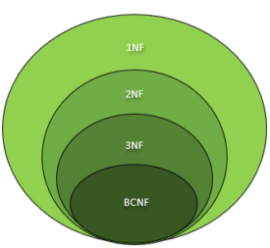
EXAMPLE
It (like, chomsky hierarchy) can be inferred that every relation in BCNF is also in 3NF. To put it another way, a relation in 3NF need not to be in BCNF. Ponder over this statement for a while.
To determine the highest normal form of a given relation R with functional dependencies, the first step is to check whether the BCNF condition holds. If R is found to be in BCNF, it can be safely deduced that the relation is also in 3NF, 2NF and 1NF as the hierarchy shows. The 1NF has the least restrictive constraint – it only requires a relation R to have atomic values in each tuple. The 2NF has a slightly more restrictive constraint. The 3NF has more restrictive constraint than the first two normal forms but is less restrictive than the BCNF. In this manner, the restriction increases as we traverse down the hierarchy.

Slide 53
Fourth Normal Form
A relation will be in 4NF if it is in Boyce Codd normal form and has no multi-valued dependency.
For a dependency A → B, if for a single value of A, multiple values of B exists, then the relation will be a multi-valued dependency.

Slide 54
4th Normal Form
An entity is in Fourth Normal Form (4NF) when it meets the requirement of being in Third Normal Form (3NF) and additionally: Has no multiple sets of multi-valued dependencies.
In other words, 4NF states that no entity can have more than a single one-to-many relationship within an entity if the one-to-many attributes are independent of each other.
Fourth Normal Form applies to situations involving many-to-many relationships.
In relational databases, many-to-many relationships are expressed through cross-reference tables.
Definition: A table is in fourth normal form (4NF) if and only if it is in BCNF and contains no more than one multi-valued dependency.

Slide 55
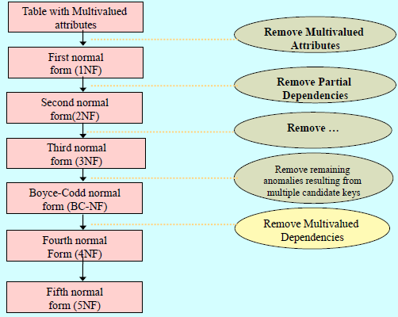

Slide 56
Example: 4th NF
Consider the database table of a class which has two relations R1 contains student ID(SID) and student name (SNAME) and R2 contains course id(CID) and course name (CNAME).
Table – R1(SID, SNAME)
Table – R2(CID, CNAME)
Table – R1 X R2
SID | SNAME
S1 | A
S2 | B
CID | CNAME
C1 | C
C2 | D
SID | SNAME | CID | CNAME
S1 | A | C1 | C
S1 | A | C2 | D
S2 | B | C1 | C
S2 | B | C2 | D
When there cross product is done it resulted in multivalued dependencies:
Multivalued dependencies (MVD) are:
SID->->CID; SID->->CNAME; SNAME->->CNAME

Slide 57
Fourth Normal Form
Let us see an example −
<Movie>
The above is not in 4NF, since
Many shooting locations can have the same movie
More than one movie can have the same listing
Movie_Name | Shooting_Location | Listing
MovieOne | UK | Comedy
MovieOne | UK | Thriller
MovieTwo | Australia | Action
MovieTwo | Australia | Crime
MovieThree | India | Drama

Slide 58
Fourth Normal Form
Movie_Name | Shooting_Location
MovieOne | UK
MovieOne | UK
MovieTwo | Australia
MovieTwo | Australia
MovieThree | India
Let us convert the above table in 4NF −
<Movie_Shooting>
<Movie_Listing>
Now the violation is removed and the tables are in 4NF.
Movie_Name | Listing
MovieOne | Comedy
MovieOne | Thriller
MovieTwo | Action
MovieTwo | Crime
MovieThree | Drama

Slide 59
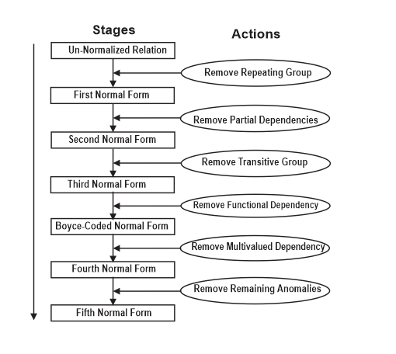

Slide 60
Fifth Normal Form
The 5NF (Fifth Normal Form) is also known as project-join normal form. A relation is in Fifth Normal Form (5NF), if it is in 4NF, and won’t have lossless decomposition into smaller tables.
You can also consider that a relation is in 5NF, if the candidate key implies every join dependency in it.
Example
The below relation violates the Fifth Normal Form (5NF) of Normalization −
<Employee>
The above relation can be decomposed into the following three tables; therefore, it is not in 5NF −
EmpName | EmpSkills | EmpJob (Assigned Work)
David | Java | E145
John | JavaScript | E146
Jamie | jQuery | E146
Emma | Java | E147

Slide 61
Fifth Normal Form
EmployeeSkills>
The following is the <EmployeeJob> relation that displays the jobs assigned to each employee −
<EmployeeJob>
Here is the skills that are related to the assigned jobs −
<JobSkills>
Our Join Dependency −
The above relations have join dependency, so they are not in 5NF. That would mean that a join relation of the above three relations is equal to our original relation <Employee>.
EmpName | EmpSkills
David | Java
John | JavaScript
Jamie | jQuery
Emma | Java
EmpName | EmpJob
David | E145
John | E146
Jamie | E146
Emma | E147
EmpSkills | EmpJob
Java | E145
JavaScript | E146
jQuery | E146
Java | E147

Slide 62
5th Normal Form
In 5th NF:
A relation that has a join dependency cannot be decomposed by a projection into other relations without spurious results
A relation is in 5NF when its information content cannot be reconstructed from several smaller relations i.e. from relations having fewer attributes than the original relation
Definition: A table is in fifth normal form (5NF) or Project-Join Normal Form (PJNF) if it is in 4NF and it cannot have a lossless decomposition into any number of smaller tables.
Fifth normal form, also known as join-projection normal form (JPNF), states that no non-trivial join dependencies exist. 5NF states that any fact should be able to be reconstructed without any anomalous results in any case, regardless of the number of tables being joined. A 5NF table should have only candidate keys and it's primary key should consist of only a single column.

Slide 63
A relation R is in 5NF if and only if every join dependency in R is implied by the candidate keys of R. A relation decomposed into two relations must have loss-less join Property, which ensures that no spurious or extra tuples are generated, when relations are reunited through a natural join.
Properties – A relation R is in 5NF if and only if it satisfies following conditions:
R should be already in 4NF.
It cannot be further non loss decomposed (join dependency)
Example – Consider the schema, with a case as “if a company makes a product and an agent is an agent for that company, then he always sells that product for the company”. Under these circumstances, the ACP table is shown as:
AGENT | COMPANY | PRODUCT
A1 | PQR | Nut
A1 | PQR | Bolt
A1 | XYZ | Nut
A1 | XYZ | Bolt
A2 | PQR | Nut
Table – ACP

Slide 64
The relation ACP is again decompose into 3 relations. Now, the natural Join of all the three relations will be shown as:
Table – R1
Table – R2
Table – R3
AGENT | COMPANY
A1 | PQR
A1 | XYZ
A2 | PQR
AGENT | PRODUCT
A1 | Nut
A1 | Bolt
A2 | Nut
COMPANY | PRODUCT
PQR | Nut
PQR | Bolt
XYZ | Nut
XYZ | Bolt
Result of Natural Join of R1 and R3 over ‘Company’ and then Natural Join of R13 and R2 over ‘Agent’and ‘Product’ will be table ACP.
Hence, in this example, all the redundancies are eliminated, and the decomposition of ACP is a lossless join decomposition. Therefore, the relation is in 5NF as it does not violate the property of lossless join.

Slide 65
Denormalization in Databases
Denormalization is a database optimization technique in which we add redundant data to one or more tables. This can help us avoid costly joins in a relational database. Note that denormalization does not mean ‘reversing normalization’ or ‘not to normalize’. It is an optimization technique that is applied after normalization.
Basically, The process of taking a normalized schema and making it non-normalized is called denormalization, and designers use it to tune the performance of systems to support time-critical operations.
How is Denormalization Different From Normalization ?
One side normalization is used for reduce or removing the redundancy which means there will be no duplicate data or entries in the same table and also optimizes for data integrity and efficient storage, while Denormalization is used for add the redundancy into normalized table so that enhance the functionality and minimize the running time of database queries (like joins operation ) and optimizes for performance and query simplicity.

Slide 66

Denormalization in Databases
Advantages of Denormalization
Improved Query Performance: Denormalization can improve query performance by reducing the number of joins required to retrieve data.
Reduced Complexity: By combining related data into fewer tables, denormalization can simplify the database schema and make it easier to manage.
Easier Maintenance and Updates: Denormalization can make it easier to update and maintain the database by reducing the number of tables.
Improved Read Performance: Denormalization can improve read performance by making it easier to access data.
Better Scalability: Denormalization can improve the scalability of a database system by reducing the number of tables and improving the overall performance.

Slide 67

Denormalization in Databases
Disadvantages of Denormalization
Reduced Data Integrity: By adding redundant data, denormalization can reduce data integrity and increase the risk of inconsistencies.
Increased Complexity: While denormalization can simplify the database schema in some cases, it can also increase complexity by introducing redundant data.
Increased Storage Requirements: By adding redundant data, denormalization can increase storage requirements and increase the cost of maintaining the database.
Increased Update and Maintenance Complexity: Denormalization can increase the complexity of updating and maintaining the database by introducing redundant data.

Slide 68
THANK YOU

